Slide 1


Slide 2
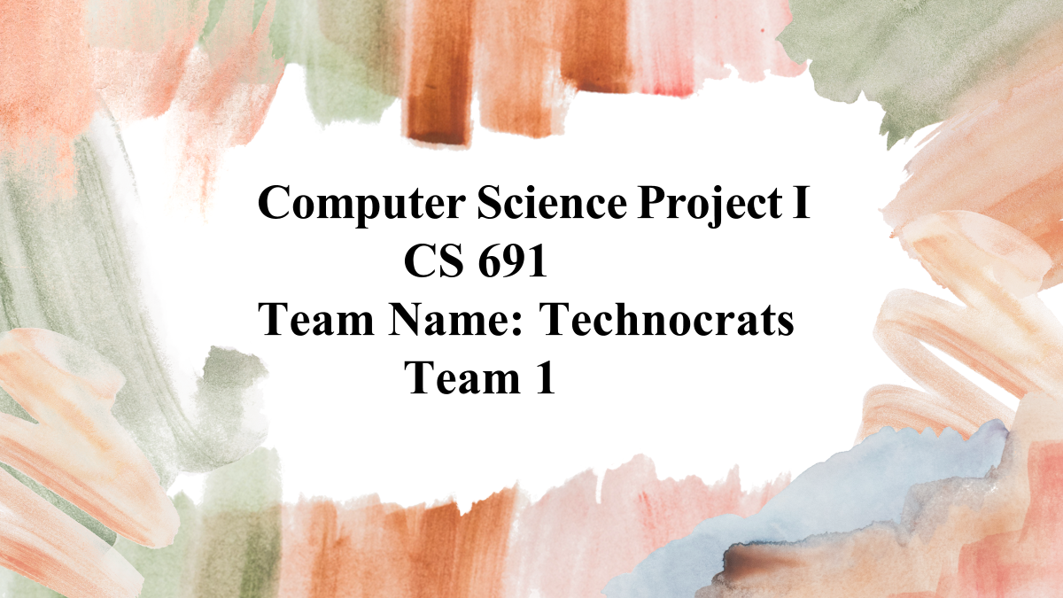

Slide 3
AGENDA
PROBLEM STATEMENT
&
PROJECT DESCRIPTION
&
PERSONAS
MINIMAL VIABLE PRODUCT
PROJECT DEMO SPRINT 4
&
APP SCREENSHOT
METRICS
& RETROSPECTIVE
&
SPRINT 5
&
APP LOGO
ARCHITECTURE DIAGRAM & TECHNOLOGIES
SPRINT BACKLOG
&
ACCEPTANCE CRITERIA
&
TEST CASES
SPRINT 3 RECAP
&
PRODUCT BACKLOG
&
SPRINT SUMMARY

Slide 4
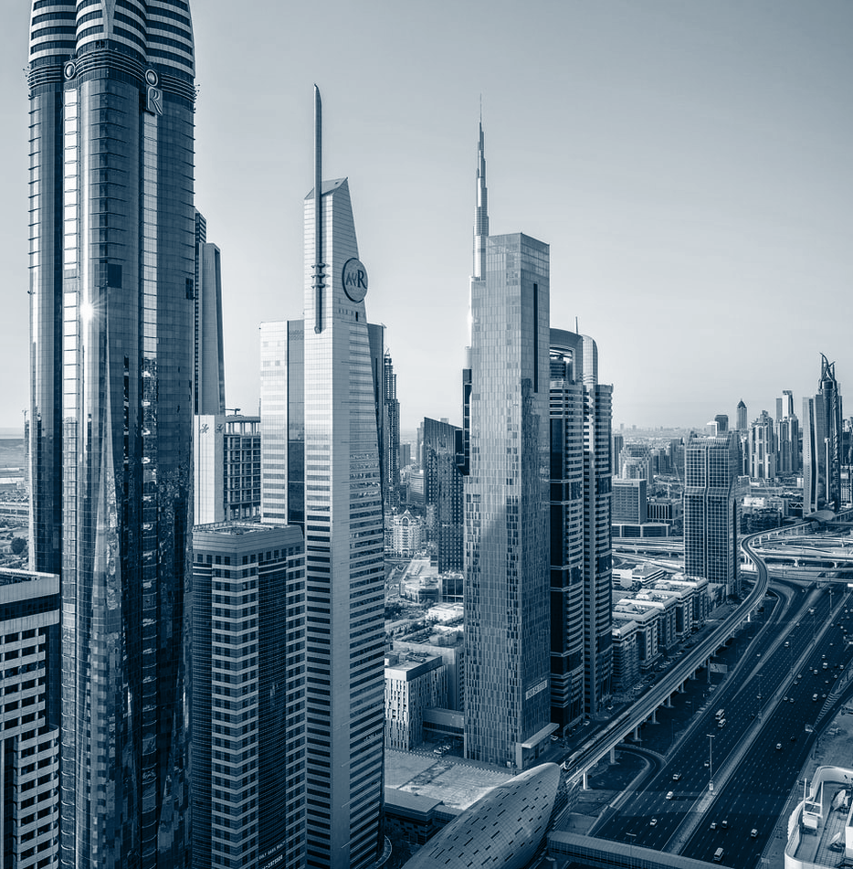
Covid-19 Safety Protocol Tracker

Slide 5
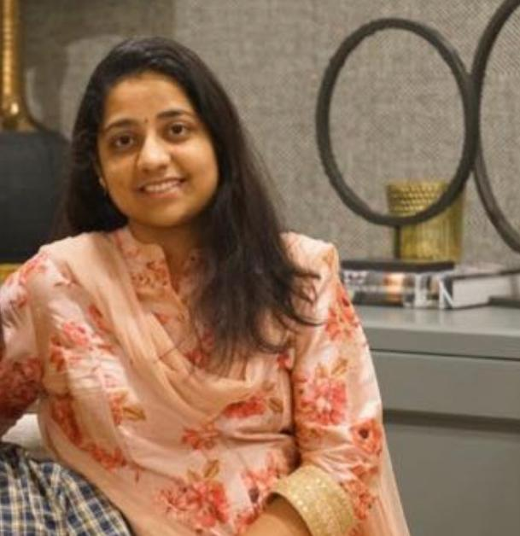
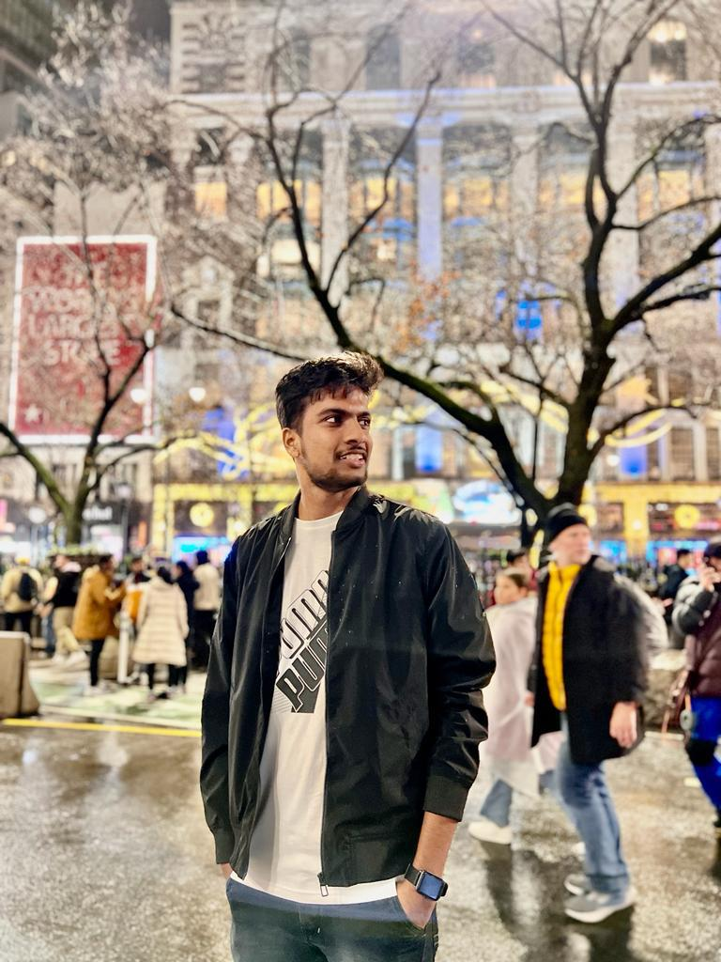
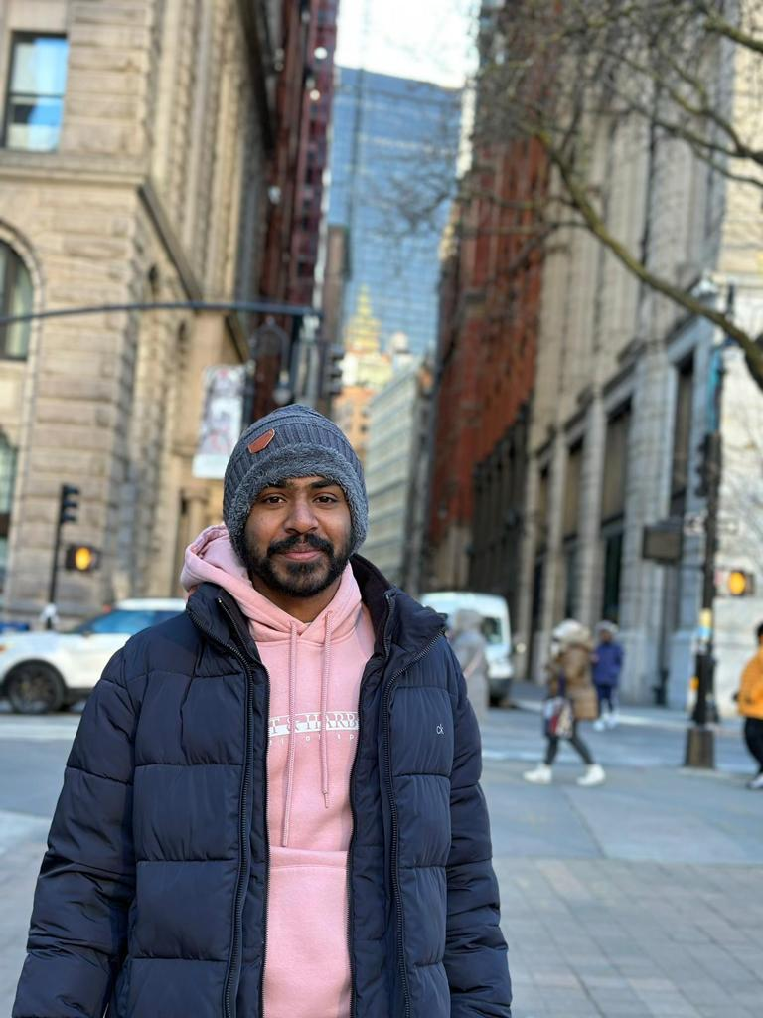
TEAM MEMBER ROLES
Sai Sindhu
Developer
Anil Babu
Developer
Anivi Reddy
Developer

Slide 6
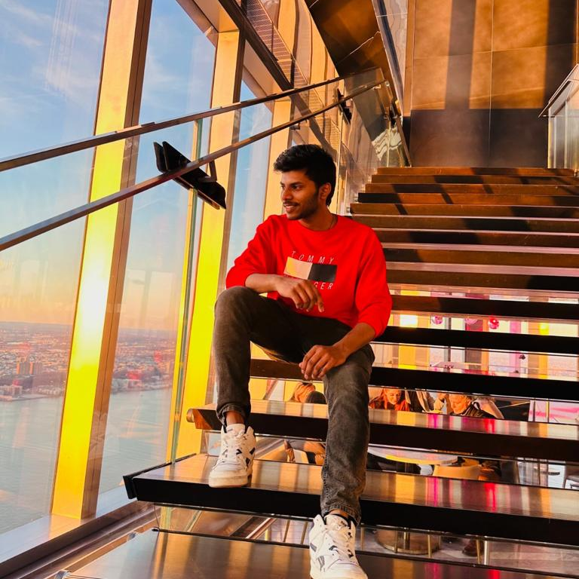
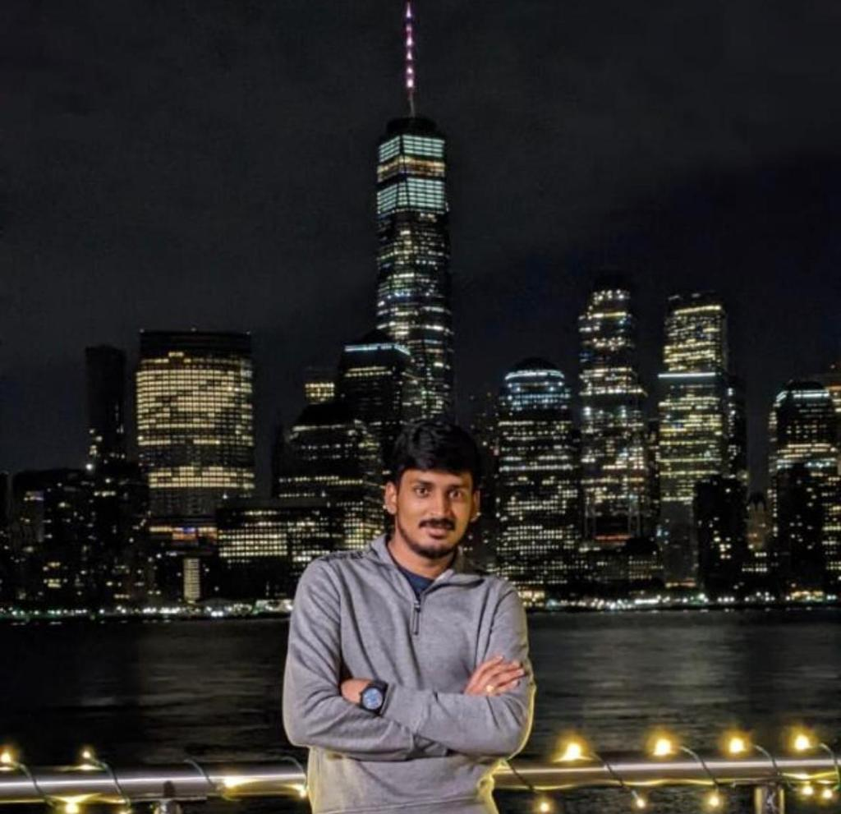

TEAM MEMBER ROLES
Sahith
Quality
Analyst/Tester
Bharadwaja
Developer
NIKHIL
Scrum master &
QUALITY ANALYST

Slide 7
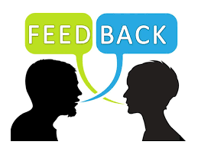

IMPROVEMENTS MADE FROM PROFESSOR'S FEEDBACK
Improvements from Professor's feedback slide can be listed by using bullet points making it more visible to the user.
Change the MVP slide introductory image. The image does not show MVP.
Conceptual Architecture Diagram can be improved by showing what technologies at which step they are being used.
No need for the "Place" column in the presentation. In Backlog the team just needs to show the last sprint backlog in this case Sprint 3.
Sprint 1 does not need any kind of metrics.
The same Burndown chart was being used in Sprint 2. Every sprint has different burndown charts.
The team needs to work more on Retrospective.

Slide 8

PROBLEM STATEMENT
Over the last two years, Social Distancing has become increasingly prevalent as a part of the Covid-19 pandemic outbreak. According to international health authorities, interpersonal communication is the principal primary contributor to the pandemic's spread. To avoid the spreading, it is therefore necessary to maintain the necessary spacing with some effort. In addition, developing an automated Contact Detection step that secures privacy would be beneficial to prevent further infection. Today's smartphones are not just for communication; they can also detect numerous characteristics of their environment (movement, proximity, orientation, etc.). In addition, now a days practically everyone utilizes a smartphone. Reflect on these facts The issue is resolved by a mobile app that can notify users when it detects that a person is approaching from a closer distance than is advised.

Slide 9

PROJECT DESCRIPTION
Our product is focused on COVID-19 safety Protocols. It is designed to ensure that people are adhering to social distancing guidelines. Ultimately, it can help make people and the community safer from the virus . This is a tracking app that uses a smartphone's GPS and Bluetooth features to track COVID-19 case. Bluetooth technology enables users to assess their risk of being exposed to the COVID-19 virus if they have been within six feet of a confirmed case. It is also able to detect specific locations that are deemed 'infected area’s through location data analysis, and crowd sourcing. this data so it is easily accessible for decision making purpose. The idea behind the app was to make people aware of their risk, and give them the tools to protect themselves from contracting the virus. We developed a product that would be a cost-effective measure for protecting profits and human life. The idea for our product is based on the idea of a "control" to prevent COVID-19 from spreading. It would be an app that uses Bluetooth and GPS capabilities to track COVID-19 cases and would also provide alerts in case it detects COVID-19 in an area. This product was designed to be inexpensive, effective, providing information necessary for the public's awareness of where the virus is being spread. We designed this app as incentive to prevent someone from spreading the virus as they are able to see how close they are getting near people who have contacted it.

Slide 10
TEAM WORKING AGREEMENT
Communication:
We agree to communicate regularly and effectively, keeping each other informed about our progress, questions, and concerns. All the team members agree to have meetings via teams weekly twice.
Participation:
We agree to actively participate in all team meetings and discussions, and to contribute our unique skills and perspectives to the project.
Deadlines:
We agree to meet all deadlines set by the team and to inform the team as early as possible if we anticipate any difficulties meeting a deadline.
Respect:
We agree to always treat each other with respect and professionalism, even in the face of disagreements or challenges.
Feedback:
We agree to give and receive constructive feedback openly and honestly, with the goal of improving our work and the project.
Roles and Responsibilities:
We agree to clarify our roles and responsibilities within the team, ensuring that each team member understands their specific tasks and deadlines.
Confidentiality:
We agree to maintain confidentiality about any sensitive or confidential information related to the project, as agreed upon by the team.
Quality:
We agree to prioritize quality in our work, and to take the necessary time and effort to ensure that our contributions meet the standards of the team.
Conflict resolution:
We agree to resolve any conflicts or disagreements that arise within the team in a timely and respectful manner, seeking input from all team members and striving for a mutually acceptable solution.
Accountability:
We agree to hold ourselves and each other accountable for our actions and contributions to the project, and to take responsibility for any mistakes or errors we make.
Team Members:
Sai Sindhu Jammula
Anil Babu Tota
Anivi Reddy Yarabolu
Bharadwaja Vemulapally
Nikhil Reddy Thamma
Sahith Chowdary

Slide 11

PERSONAS

Slide 12

PERSONA 1
About
Christiana is a student who is pursuing her masters in a public university.
Goals
In the process of going to the college she will travel a lot and meet lot of random people who might got affected
by covid virus.so ,she want to be careful for which she need
to protect herself form covid and covid patients she use our
app which was built for covid detection of covid effected
persons nearby distances of 6ft with the help of location and Bluetooth tools .she gets notification that she was in danger zone that someone near to her is effected by covid in 6ft
distance.so that she can take precautions. Like maintain
proper social distances.
Profile
Name: Christiana
Age: 24
Location: New York, NY
Job: Student
Family: Lives with her boyfriend

Slide 13

PERSONA 2
About
Maddy is a senior nurse she will makes regular bp and
temperature of the patients.
Goals
Maddy, a nurse in a public hospital, is often overwhelmed with multiple patients. It would be immensely useful if she had a
mobile application that could detect who is within 6ft of her
location. This would make her job much easier and safer. Both
scenarios will require Maddy to do a set of certain tasks for the app to perform its intended action. For the scenario, she must create an account, install and activate her mobile application, use the app at work for it to detect where she is within 6ft of her current location. Maddy must store her account information, so the app can detect where she is within 6ft of her current location.
Profile
Name: Maddy
Age: 35
Location: New Jersey, NJ
Job: Senior nurse
Salary: $74000/year
Family: Husband

Slide 14
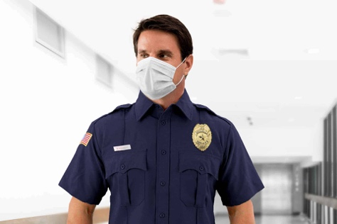
PERSONA 3
About
Sourabh was a chief security officer at a shopping complex who checks every customer at the entrances of the mall.
Goals
Sourabh goal is to check each and everything of every single customer whether they are healthy or got effected by
the covid. Through our app he gets the notification when any
persons effected by the covid is near to him in 6 ft distances.
so then he stops them and take the measures to get them the
prescribed quarantine so that the other people in the mall
doesn’t get effected.
Profile
Name: Sourabh
Age: 44
Location: Alabama, Ga
Job: Chief Security Officer
Salary: $112000/year
Family: Two children and wife

Slide 15

MINIMAL VIABLE PRODUCT (MVP)

Slide 16
MINIMAL VIABLE PRODUCT (MVP)
The following are the features we are covering in our MVP:
Onboarding screens
Registration Page
Login Page
Home Page
Scanning functionality in Bluetooth page
QR code functionality in Friends list page
Alerts Page

Slide 17
MINIMAL VIABLE PRODUCT (MVP)
Onboarding Screens :
Onboarding screen has introduction message to the app and provides basic information about the application. From onboarding screens, user has a button to login/register.
Registration Page :
User should be able to enter their details in the provided fields and click on the register button.
Login Page :
User should be able to enter their credentials and click on the login button.
Home Page :
From the home page user should be able to navigate through all the features of the application. For example Friends tab, Bluetooth tab, Notifications Tab, Settings Tab.

Slide 18
MINIMAL VIABLE PRODUCT (MVP)
Friends Tab :
QR code is displayed for the application and This QR code can be scanned by another registered application user add the current user to their friends list.
Bluetooth Tab :
Scan button is available in the blue tooth tab which will enable to device Bluetooth and scan for devices in the Bluetooth area.
Notification Tab :
User should be able to see Alerts or Notifications in this Tab.
Settings Tab :
User has option to edit their profile and send feed back about the application to admin team through this tab.

Slide 19







TECHNOLOGIES
JENNA DOE

Slide 20
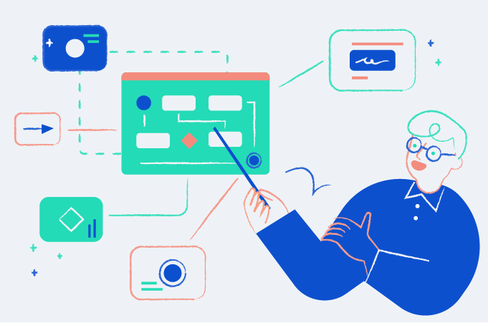
ARCHITECTURE DIAGRAM

Slide 21



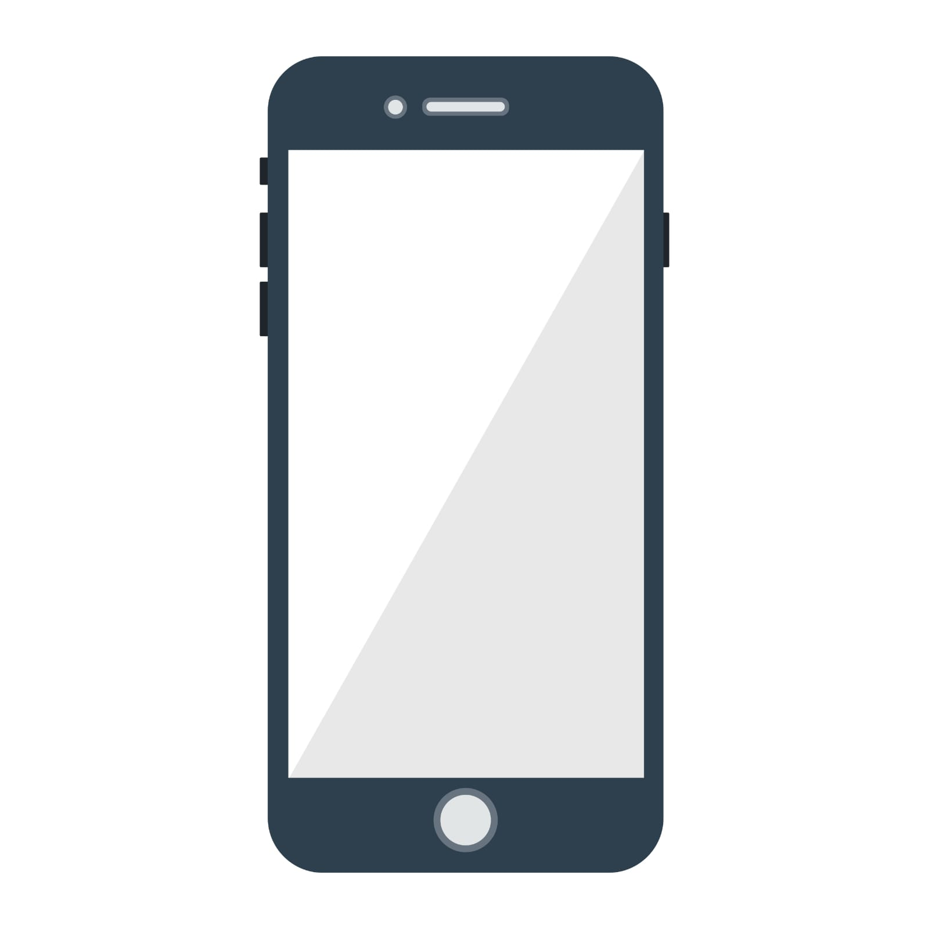






CONCEPTUAL ARCHITECTURE DIAGRAM
USER
Notifications & Alerts
Mobile Application
Machine Learning Service with Deep Neural Networks
Bluetooth Low Energy Service

Slide 22
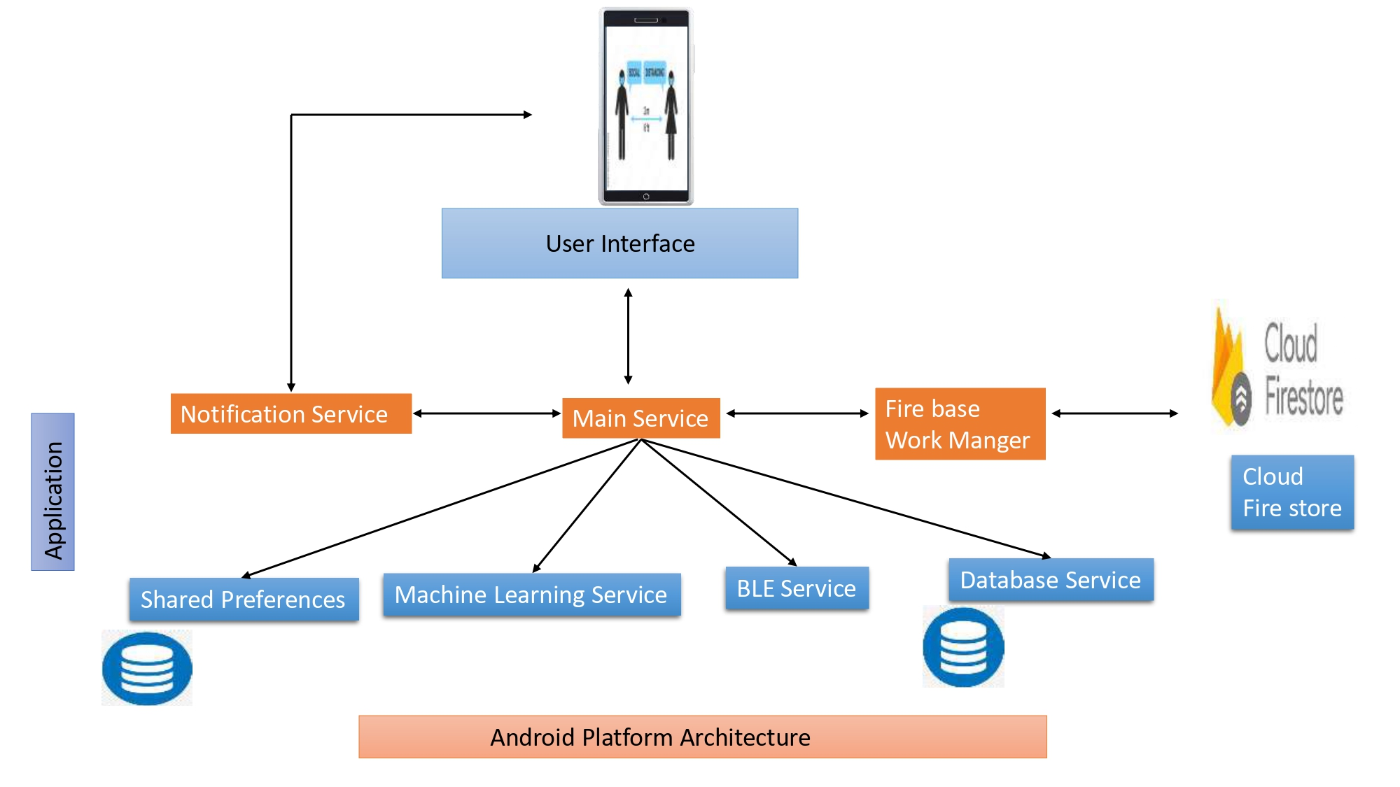
SEQUENCE ARCHITECTURE DIAGRAM

Slide 23
SPRINT 3 RECAP
ID | Summary | Status | Place
Cov-16 | As a registered user I want to logout from the application so that I can log in again whenever I want. | Done | Logout
Cov-17 | As a user, I want to create my account to the application so that I can Keep my account private and Signup Using Name, Email and Password. | Done | Sign Up
Cov-18 | As a user, I want to login using my email id as my user id so that I can access my account | Done | Login
Cov-19 | As a user, I want to navigate between pages so that I can quickly access the features I need | Done | Home page
Cov-20 | As a user, I want to access the feature in home page | Done | Home Page

Slide 24
SPRINT 3 RECAP
ID | Summary | Status
Cov-21 | As a registered user I want to see the option for changing the user’s name in settings page so that I can change the user’s name. | To be Done
Cov-22 | As a registered user I should be able to add my friends through QR code | To be Done
Cov-23 | As a registered user I want to have a functionality to send feedback about the application so that application management will get feedback from users. | To be Done
Cov-24 | As a registered user I want to see the play the button in the Bluetooth screen page so that I can start searching for infected users near my location. | To be Done
Cov-25 | As a registered user I want to see the pause button in the Bluetooth screen page so that I can stop scanning for infected users in the application. | To be Done

Slide 25
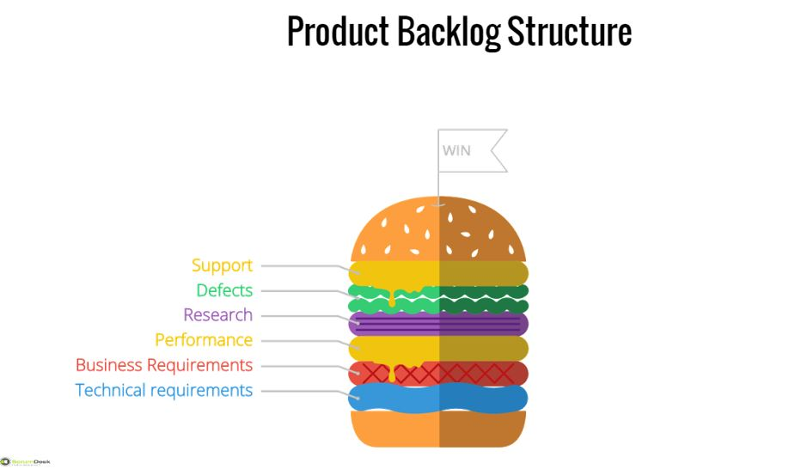
PRODUCT BACKLOG

Slide 26
PRODUCT BACKLOG
ID | Summary | Status
Cov-1 | To gather all the requirements for the project. | Done
Cov-2 | As a team we should have team work agreement with all rules and regulations. | Done
Cov-3 | As a team we should divide roles and responsibilities among ourselves to develop the project. | Done
Cov-4 | As a team we should develop required technical and functional knowledge required to complete the project. | Done
Cov-5 | As a team we should plan the product requirements and development plan for the project. | Done
Cov-6 | As a user I should have a Apk file which can be installed in mobile with basic functionalities. | Done
Cov-7 | As a user I should be able to see the welcome page for Application. | Done
Cov-8 | As a user I should be able to see the Knowledge page after welcome page , which has information of how application works. | Done
Cov-9 | As a user I should be able to give all the required permissions to application to access the required data in mobile. | Done
Cov-10 | As a user I should be able to reset the permissions for application anytime. | Done

Slide 27
PRODUCT BACKLOG
ID | Summary | Status
Cov-11 | As a user I should be able to see the Registration page for the application. | Done
Cov-12 | As a user I should be able to the user name and get registered in the application. | Done
Cov-13 | As a user I should be able to get pop up notification to turn on Bluetooth if application is being used. | Done
Cov-14 | As a user I should be able to get pop up notification, asking required permissions for the application | Done
Cov-15 | As a registered user I should be able to see the home page, once I login in to the application. | Done
Cov-16 | As a registered user I want to logout from the application so that I can log in again whenever I want. | Done
Cov-17 | As a user, I want to create my account to the application so that I can Keep my account private and Signup Using Name, Email and Password. | Done
Cov-18 | As a user, I want to login using my email id as my user id so that I can access my account | Done
Cov-19 | As a user, I want to navigate between pages so that I can quickly access the features I need | Done
Cov-20 | As a user, I want to access the feature in home page | Done

Slide 28
PRODUCT BACKLOG
ID | Summary | Status
Cov-21 | As a registered user I want to see the option for changing the user’s name in settings page so that I can change the user’s name. | Done
Cov-22 | As a registered user I should be able to add my friends through QR code. | Done
Cov-23 | As a registered user I want to have a functionality to send feedback about the application so that application management will get feedback from users. | Done
Cov-24 | As a registered user I want to see the play the button in the Bluetooth screen page so that I can start searching for infected users near my location. | To be Done
Cov-25 | As a registered user I want to see the pause button in the Bluetooth screen page so that I can stop scanning for infected users in the application. | To be Done
Cov-26 | As a registered user I want to see the option for marking as covid 19 infected person in settings page so that I can update my status whenever I diagnosed with covid. | To be Done
Cov-27 | As a registered user I should be able to send my application QR code to my friend to add in the friend list. | To be Done
Cov-28 | As a registered user I want to see the option for deleting my account in settings page so that I can delete my account. | To be Done
Cov-29 | As a registered user I should be able to white list my trusted friends. | To be Done
Cov-30 | As a registered user I should be able to remove the friends from white list. | To be Done

Slide 29
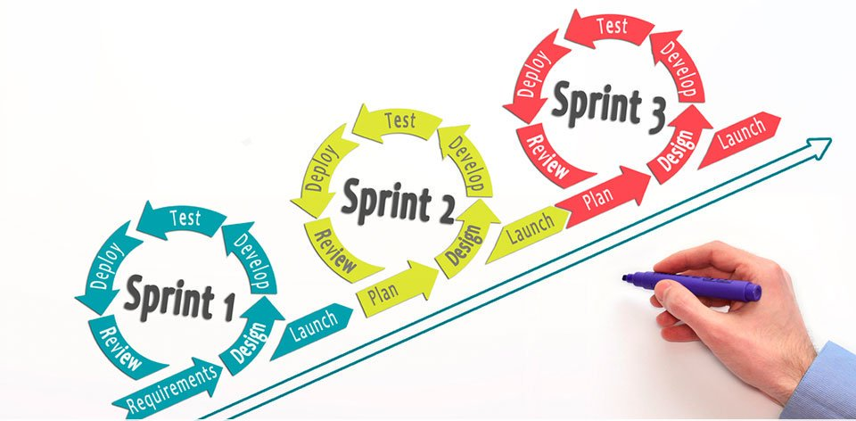
SPRINT SUMMARY

Slide 30
SPRINT 1
Our product is focused on COVID-19 safety Protocols. It is designed to ensure that people are adhering to social distancing guidelines. Ultimately, it can help make people and the community safer from the virus. This is a tracking app that uses a smartphone's GPS and Bluetooth features to track COVID-19 case.
As a user I want to be able to receive alerts when a place becomes too crowded or when I am approaching a crowded area, so that I can adjust my plans . As a user, I want to be able to access up-to-date information about the local COVID-19 situation, so that I can make informed decisions about where and when to go out.
To ensure effective teamwork in developing our social distancing project, we need to establish clear rules and regulations with a teamwork agreement. As a team, we should divide roles and responsibilities among ourselves to ensure everyone contributes effectively to the project's development. We need to develop the required technical and functional knowledge necessary to complete the project and plan the product requirements and development plan. This will help us gather all the requirements for the project and ensure that we are on track to meet our goals.
As an end-user of the social distancing application, I want an easy-to-install APK file with basic functionalities that help me stay safe during the pandemic. This includes a welcome page and a knowledge page with information on how the application works. Additionally, I want to be able to grant all necessary permissions to the application to access the required data on my mobile device. If needed, I want the option to reset these permissions at any time.

Slide 31
SPRINT 2
As the social distancing project progresses, the development team should continuously gather professor feedback to improve the application's functionality and usability. The team can then use this feedback to identify areas of improvement and prioritize new features. By regularly seeking feedback and incorporating it into the development process, the team can create an application that meets the needs of its users and helps them stay safe during the pandemic.
As an end-user of the social distancing application, I want to be able to register and create an account for the application. I should be able to see the registration page for the application and enter my username, email, and password to complete the registration process. Once registered, I should be able to log in to the application using my email ID and access my account.
To ensure the application is being used effectively, the user should receive pop-up notifications to enable Bluetooth and grant required permissions. Once logged in, registered users should be able to access the home page and navigate between pages to quickly access the features they need. Users should also have the option to log out of the application and log in again whenever they want.
Additionally, users want to access the feature in the home page, which should include all the functionalities that help them stay safe during the pandemic. This feature should be easily accessible and provide users with the necessary information and tools to maintain social distancing and follow safety guidelines. Overall, the application should be user-friendly and provide users with the necessary features to ensure their safety during the pandemic.

Slide 32
SPRINT 3
ID | Summary | Status | Place
Cov-16 | As a registered user I want to logout from the application so that I can log in again whenever I want. | Done | Logout
Cov-17 | As a user, I want to create my account to the application so that I can Keep my account private and Signup Using Name, Email and Password. | Done | Sign Up
Cov-18 | As a user, I want to login using my email id as my user id so that I can access my account | Done | Login
Cov-19 | As a user, I want to navigate between pages so that I can quickly access the features I need | Done | Home page
Cov-20 | As a user, I want to access the feature in home page | Done | Home Page

Slide 33
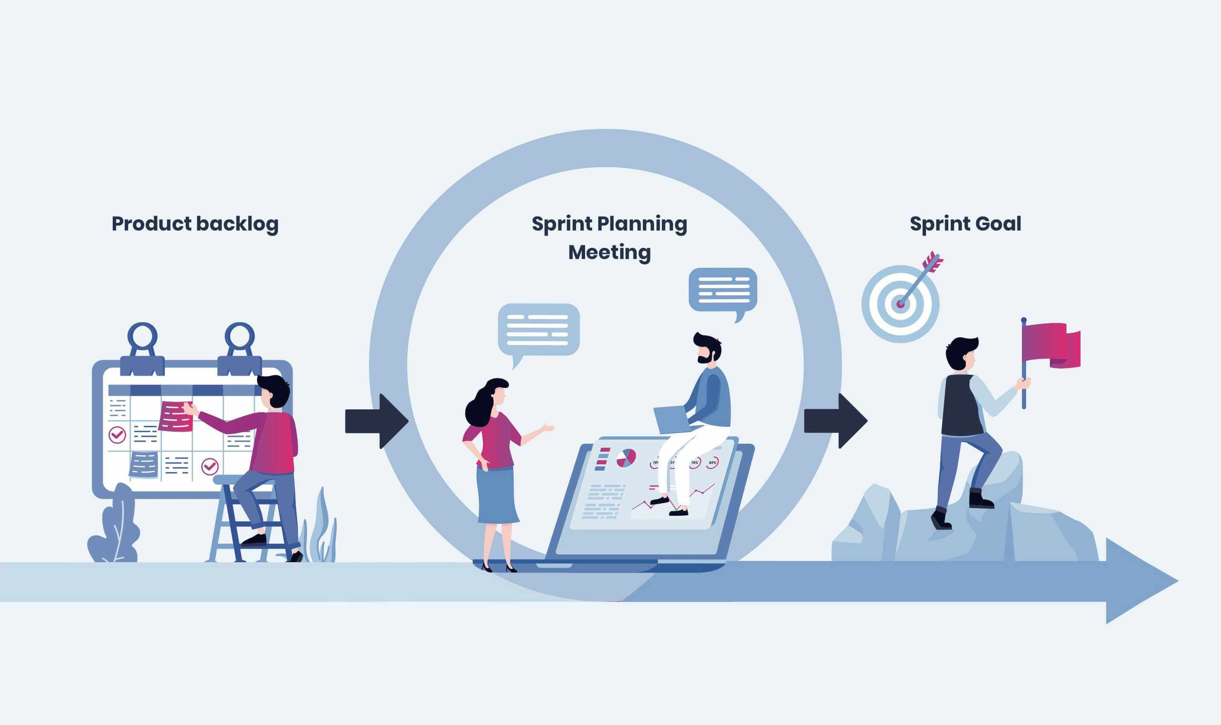
SPRINT BACKLOG

Slide 34
SPRINT 4 BACKLOG
ID | Summary | Status
Cov-21 | As a registered user I want to see the option for changing the user’s name in settings page so that I can change the user’s name. | To be Done
Cov-22 | As a registered user I should be able to add my friends through QR code | To be Done
Cov-23 | As a registered user I want to have a functionality to send feedback about the application so that application management will get feedback from users. | To be Done
Cov-24 | As a registered user I want to see the play the button in the Bluetooth screen page so that I can start searching for infected users near my location. | To be Done
Cov-25 | As a registered user I want to see the pause button in the Bluetooth screen page so that I can stop scanning for infected users in the application. | To be Done

Slide 35
SPRINT 4 BACKLOG
ID | Summary | Status
Cov-21 | As a registered user I want to see the option for changing the user’s name in settings page so that I can change the user’s name. | Done
Cov-22 | As a registered user I should be able to add my friends through QR code | Done
Cov-23 | As a registered user I want to have a functionality to send feedback about the application so that application management will get feedback from users. | Done

Slide 36
ACCEPTANCE CRITERIA TABLE
ID | Scenario | Summary | Place
Cov-21 | As a registered user I want to see the option for changing the user’s name in settings page so that I can change the user’s name. | Given am a user of the application. I want to see the option for changing the user's name in the settings page so that I can update the user's name as needed. As a user, I want the option for changing the user's name to be clearly labeled in the settings page so that I can easily find and use it. so that I can update the user's name if it was entered incorrectly. I want the option for changing the user's name in the settings page so that I can change the user's name if it no longer accurately reflects the user's identity. | Home page
Cov-22 | As a registered user I should be able to add my friends through QR code | Given am a user of the application I want to see the QR code generated in my application so that I can send QR code to my friends and so that I can add them in my friends list. | Home page

Slide 37
ACCEPTANCE CRITERIA TABLE
ID | Scenario | Summary | Place
Cov-23 | As a registered user I want to have a functionality to send feedback about the application so that application management will get feedback from users. | Given am the user of the application I want to see the option for sending feedback to the admin team of the application so that I can share my feedback about application to the admin team of the application. | Home page

Slide 38
TEST CASES
ID | Unit Of Test | Scenario | Test Data | Steps to be Expected | Expected Result
Cov-21 | Home page | As a registered user I want to see the option for changing the user’s name in settings page so that I can change the user’s name. | Login as a registered user. Navigate to the settings page. Verify that an option for changing the user's name is displayed. | Login>Homepage | An option for changing the user's name is displayed in the settings page for registered users.
Cov-22 | Home page | As a registered user I should be able to add my friends through QR code. | Friends Tab, Scenario : As a registered user I want to see the QR code in my application so that I can send QR code to my friends. Test data : Login as a registered user, Navigate to the Friends Tab , scan the QR code generated by the application from another device, verify that the you added to the friends list of registered user of another device. | Login > Friends Tab | The user is added to the friends list by using QR code

Slide 39
TEST CASES
ID | Unit of Test | Scenario | Test Data | Steps to be Expected | Expected Result
Cov-23 | Home page | As a registered user I want to have a functionality to send feedback about the application so that application management will get feedback from users. | Login as a registered user, Navigate to settings page, click on the send feedback button , compose the message and send the feedback. verify that the mail Login as a registered user, Navigate to settings page, click on the send feedback button , compose the message and send the feedback. verify that the mail has been sent to the recipient. has been sent to the recipient. | Login>Settings | Main has been successfully sent to the recipient.

Slide 40
Stories Completed in Sprint 4
ID | Summary | Status
Cov-21 | As a registered user I want to see the option for changing the user’s name in settings page so that I can change the user’s name. | Done
Cov-22 | As a registered user I should be able to add my friends through QR code. | Done
Cov-23 | As a registered user I want to have a functionality to send feedback about the application so that application management will get feedback from users. | Done

Slide 41
Stories not Completed in Sprint 4
ID | Summary | Status
Cov-24 | As a registered user I want to see the play the button in the Bluetooth screen page so that I can start searching for infected users near my location. | To be Done
Cov-25 | As a registered user I want to see the pause button in the Bluetooth screen page so that I can stop scanning for infected users in the application. | To be Done

Slide 42

METRICS

Slide 43
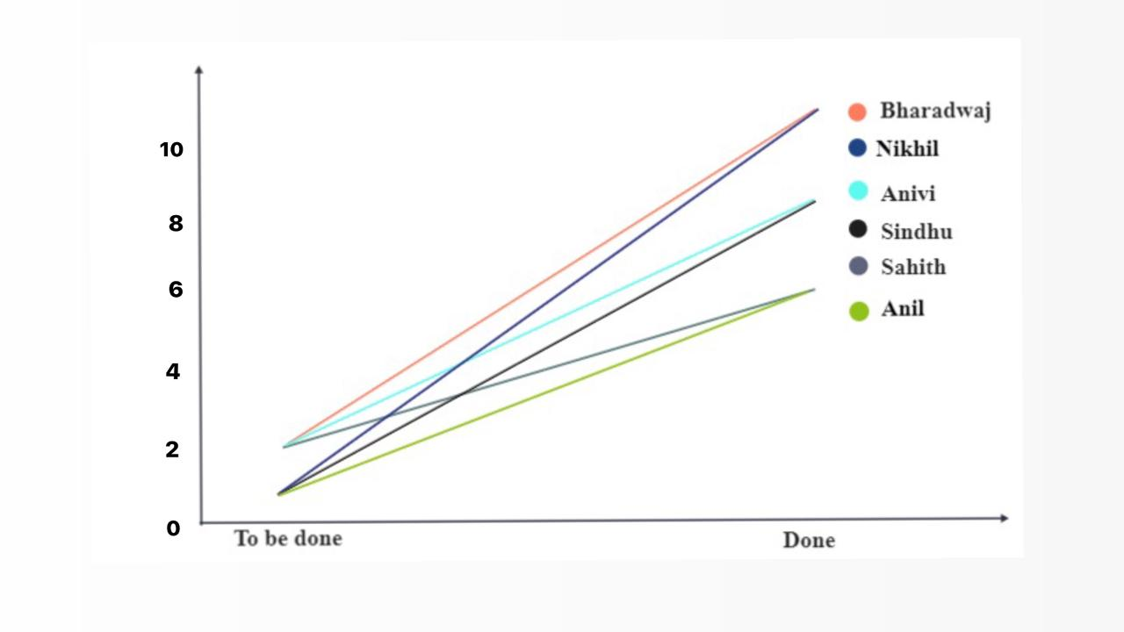
METRICS
TEAM MEMBERS VELOCITY REPORT

Slide 44
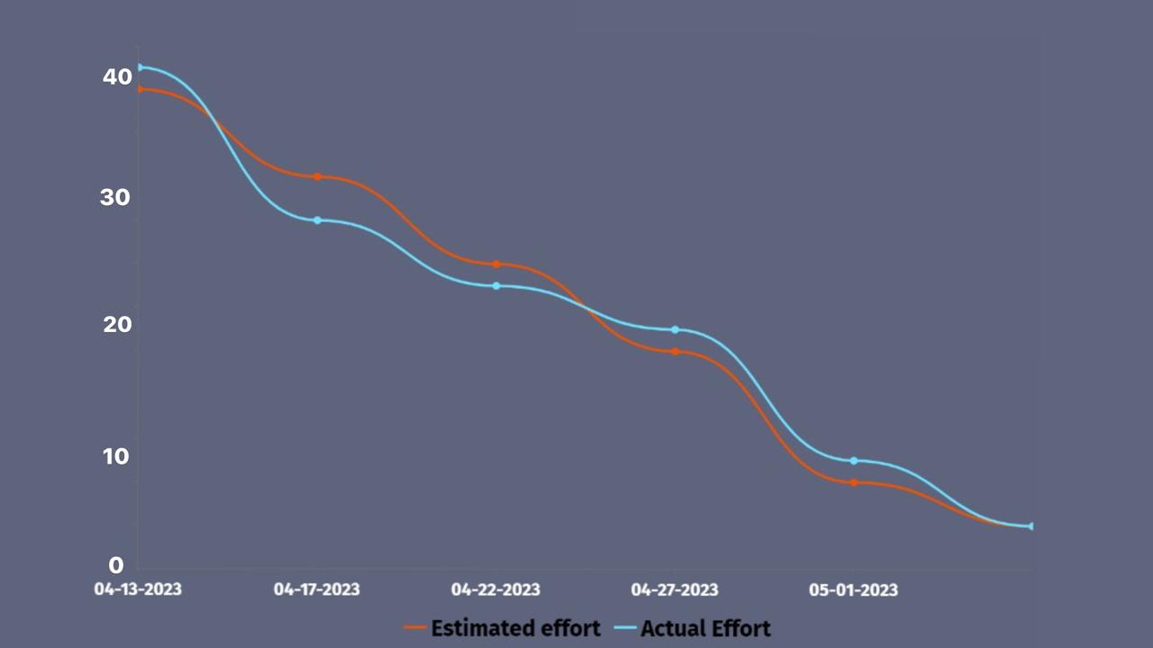
METRICS
SPRINT BURNDOWN CHART

Slide 45
RETROSPECTIVE
What went well?
We have planned and distributed the tasks in a organised way and executed it. Team meetings were conducted on time with out fail to get the updates from team members.
What needs improvement?
Co-ordination and communication between team members can be improved so that it will avoid reworking. Team members must complete their tasks on time with out fail.
Next steps:
We are going to maintain status report from next sprint so that we can note down the team members status and their updates. We are going to put a deadline for user stories earlier so that we have some time for unexpected last minute tasks.

Slide 46

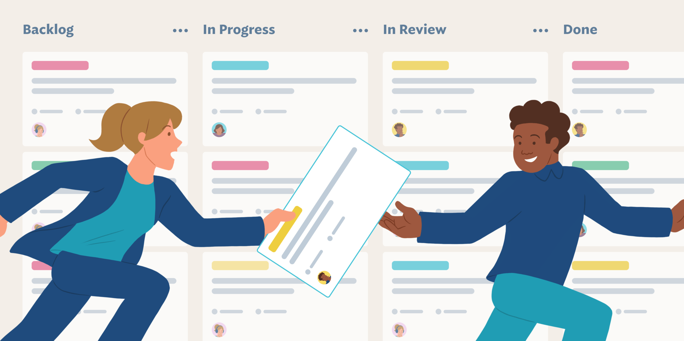
SPRINT 5

Slide 47
Stories planned and committed for Sprint 5
ID | Summary | Status
Cov-24 | As a registered user I want to see the play the button in the Bluetooth screen page so that I can start searching for infected users near my location. | To be Done
Cov-25 | As a registered user I want to see the pause button in the Bluetooth screen page so that I can stop scanning for infected users in the application. | To be Done
Cov-26 | As a registered user I want to see the option for marking as covid 19 infected person in settings page so that I can update my status whenever I diagnosed with covid. | To be Done
Cov-27 | As a registered user I should be able to send my application QR code to my friend to add in the friend list. | To be Done
Cov-28 | As a registered user I want to see the option for deleting my account in settings page so that I can delete my account. | To be Done
Cov-29 | As a registered user I should be able to white list my trusted friends. | To be Done
Cov-30 | As a registered user I should be able to remove the friends from white list. | To be Done

Slide 48
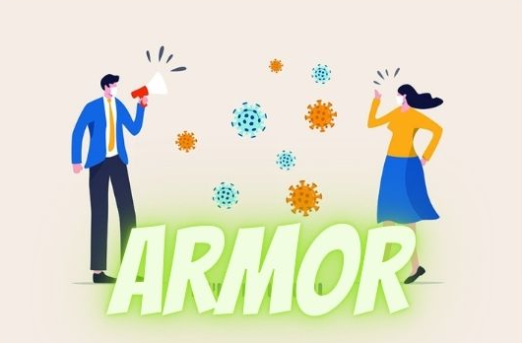
App Logo

Slide 49

PROJECT DEMO SPRINT 4

Slide 50
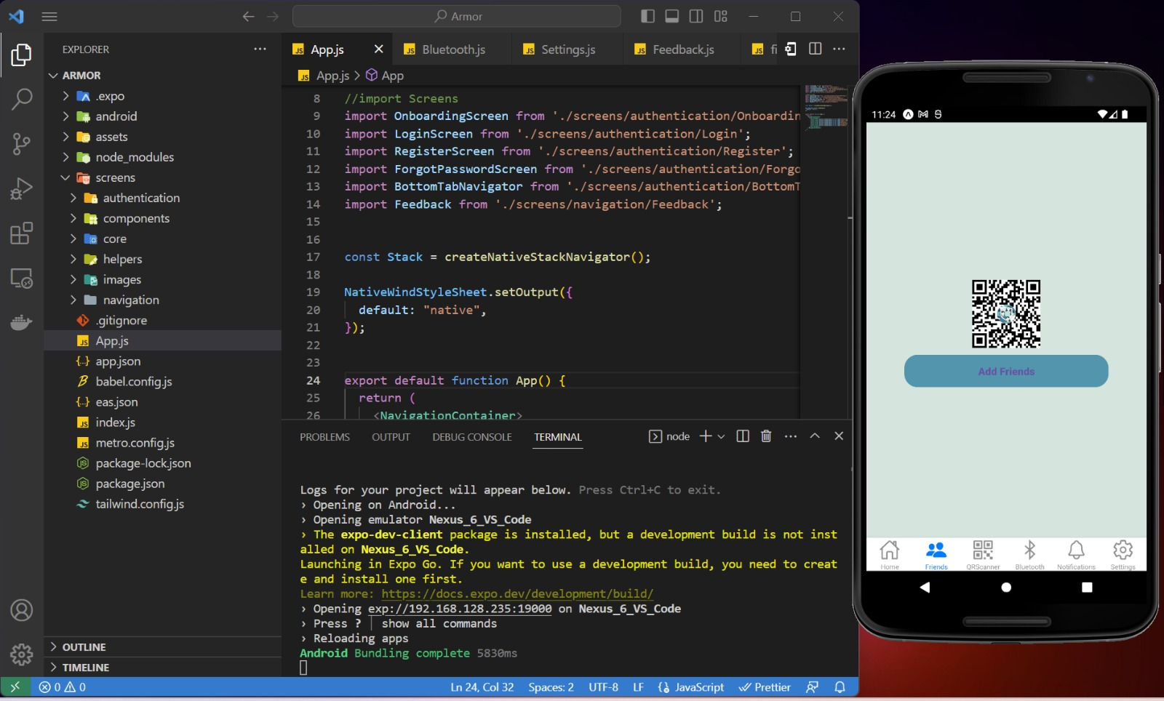
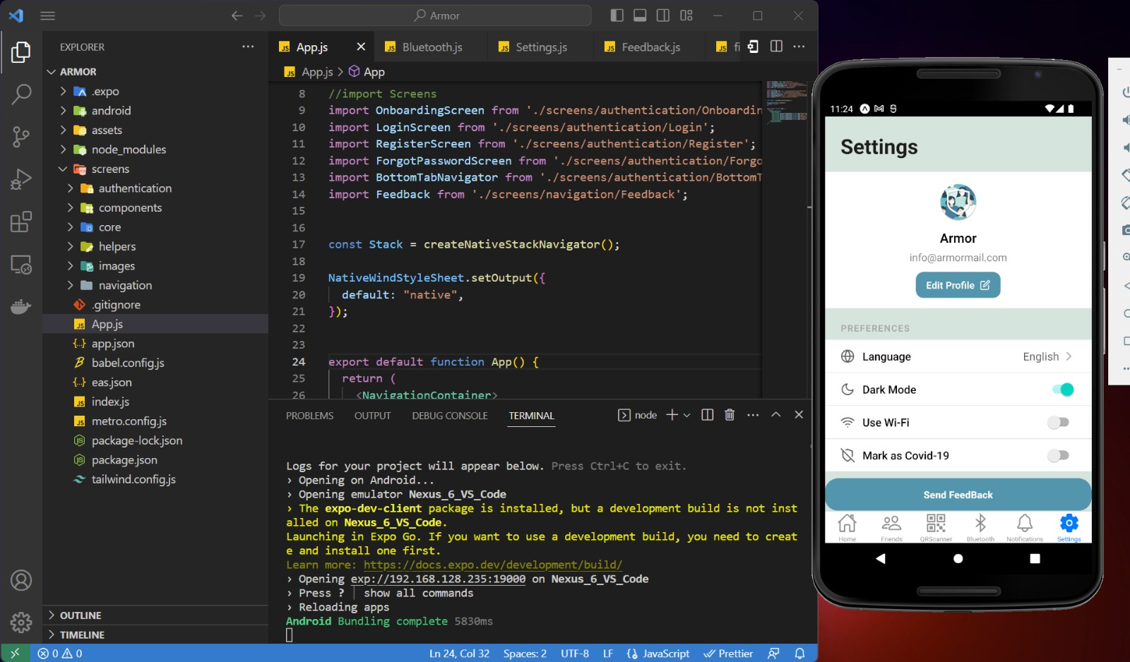
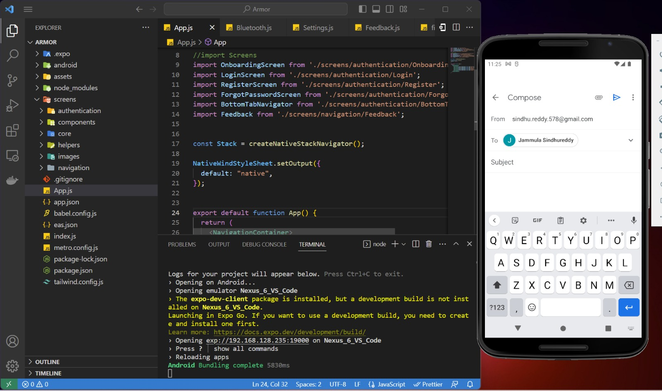
PROJECT DEMO SPRINT 4
Project Demo:

Slide 51
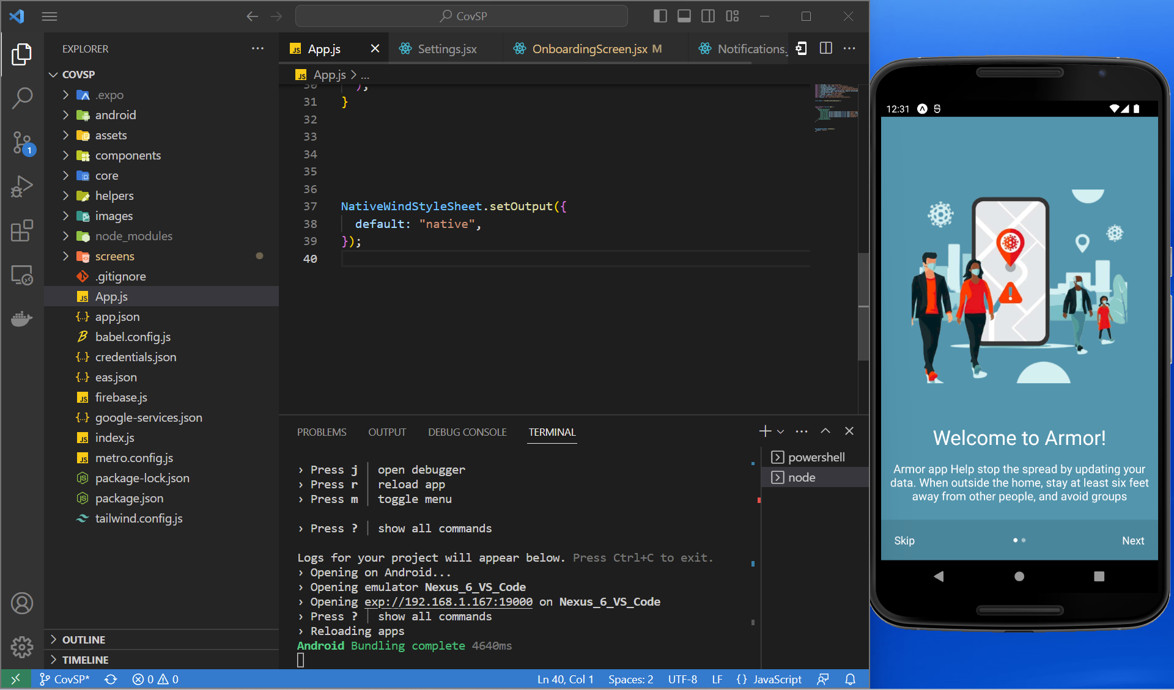
App Screenshot
Welcome Page

Slide 52
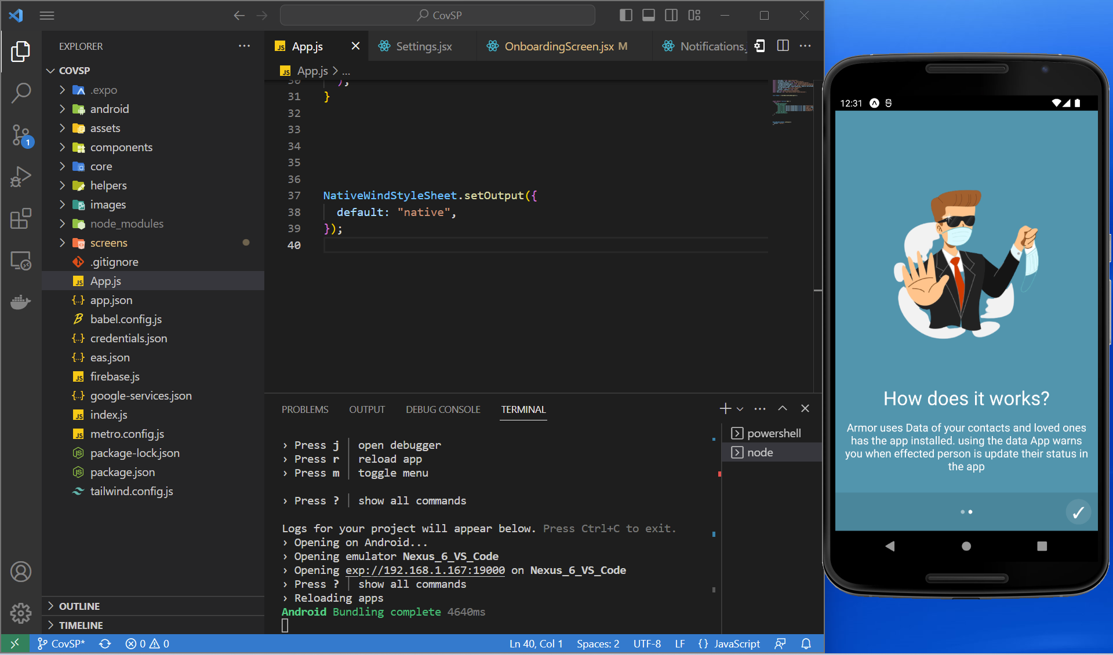
App Screenshot
Onboarding Screen

Slide 53
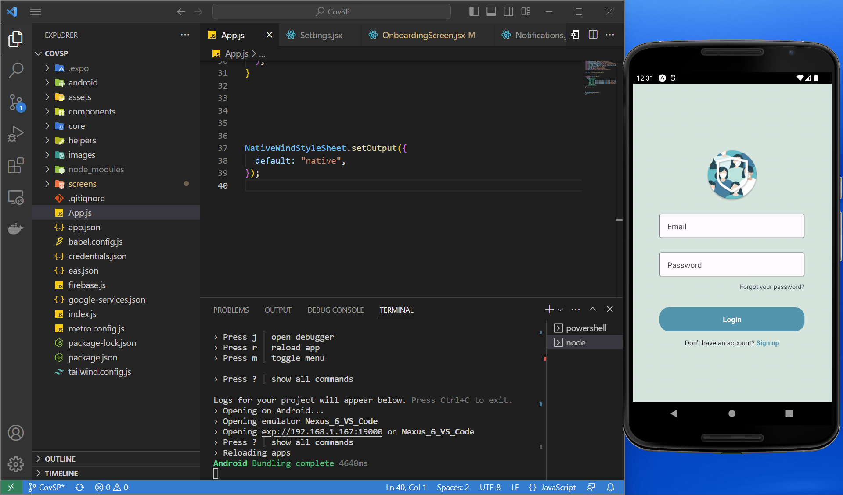
App Screenshot
Login Page

Slide 54
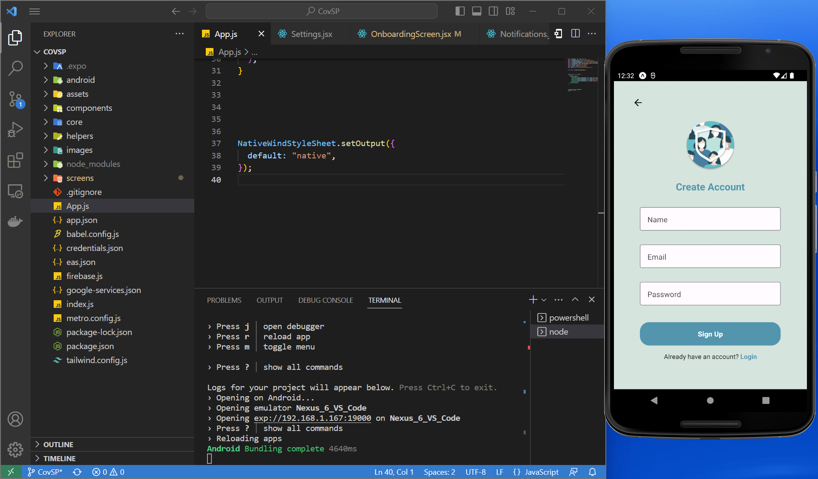
App Screenshot
Registration Page

Slide 55
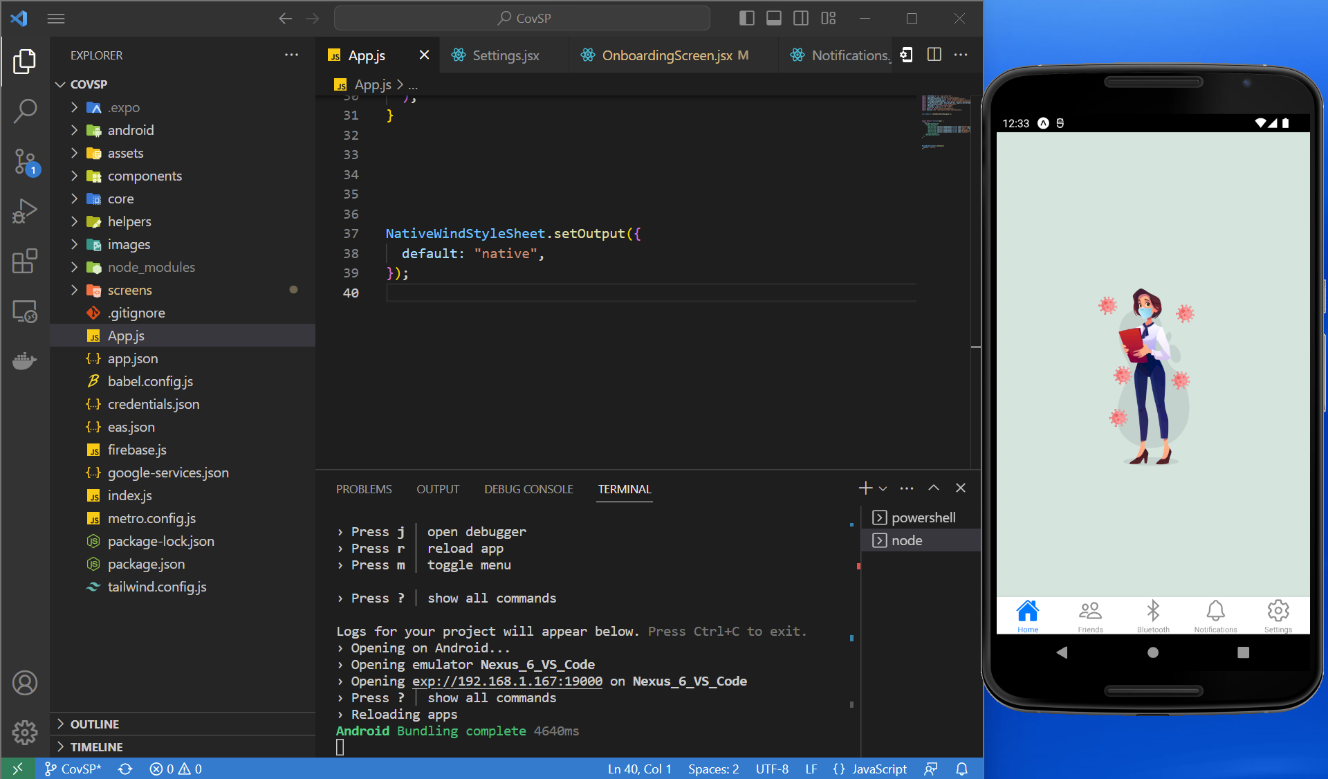
App Screenshot
Home Page After Login

Slide 56
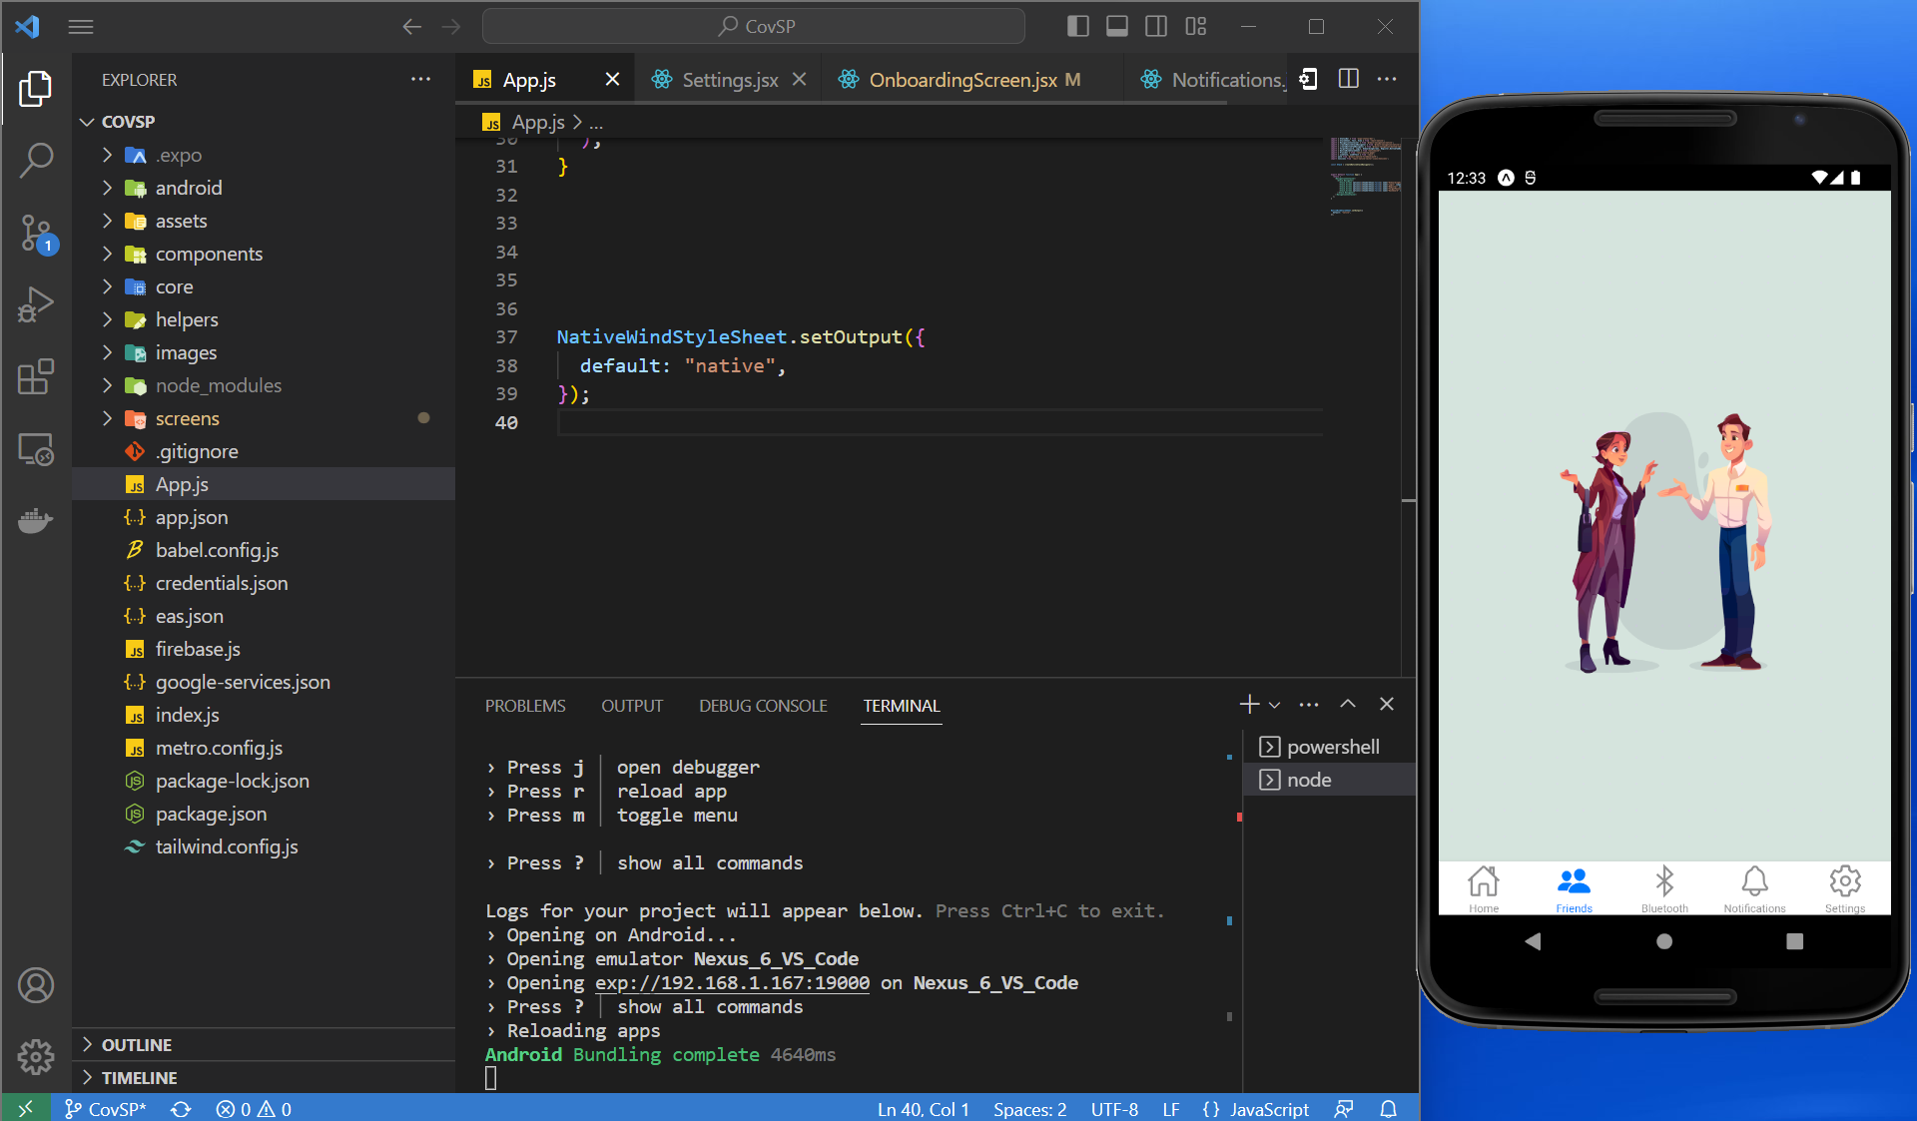
App Screenshot
Friends

Slide 57
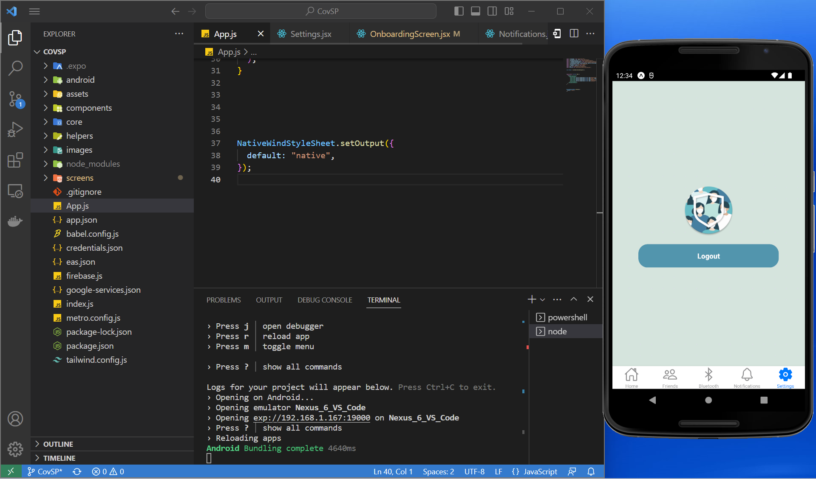
App Screenshot
Settings

Slide 58
App Screenshot
Friends List

Slide 59
App Screenshot
Edit Profile

Slide 60
App Screenshot
Feedback

Slide 61
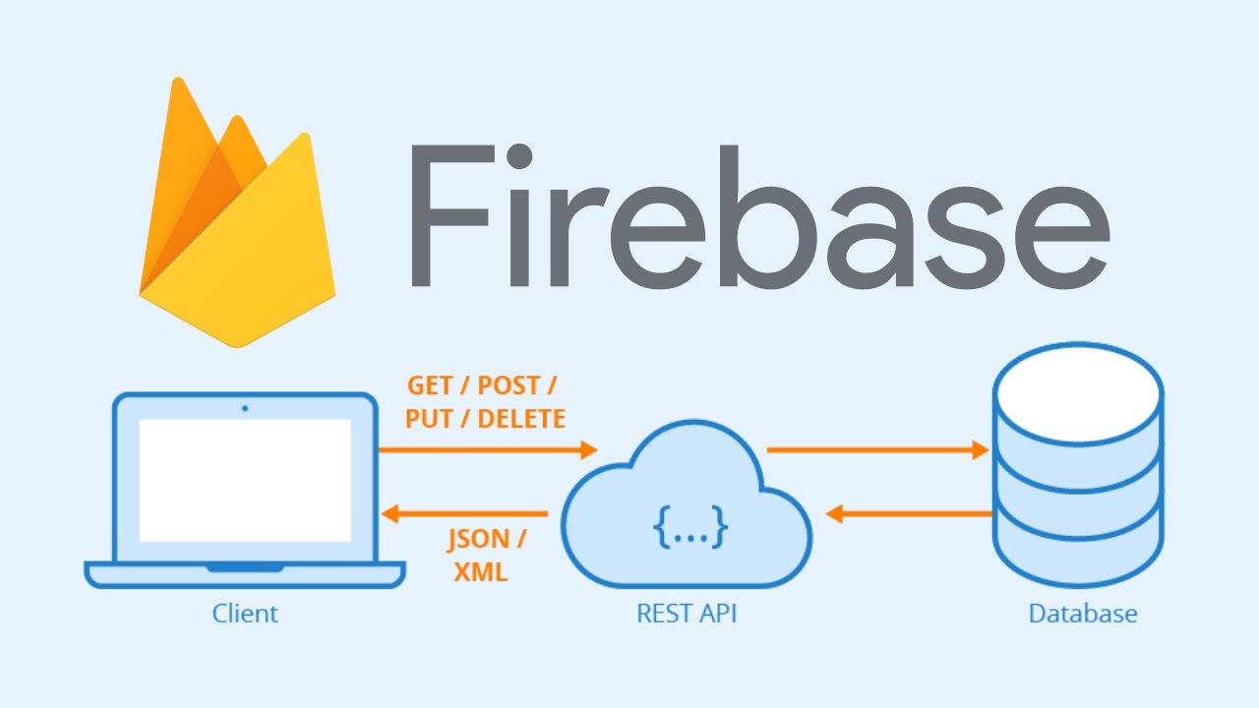
API

Slide 62

GITHUB LINK
https://github.com/htmw/2023S-Team1

Slide 63
PROJECT DEMO SPRINT 4
Live Application Demo:

Slide 64


